Slide 1
Lectures 9
Laser Guide Stars
Claire Max
Astro 289, UC Santa Cruz
February 6, 2020

Slide 2
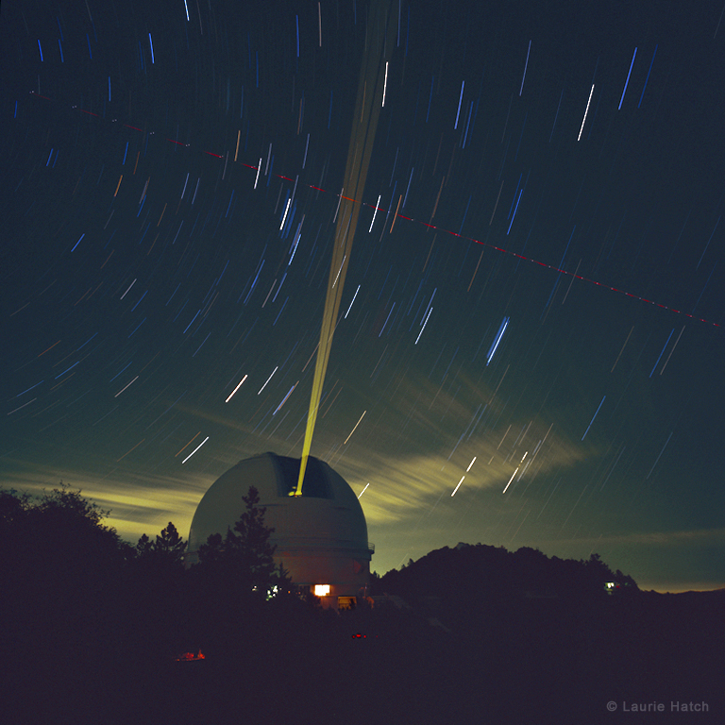
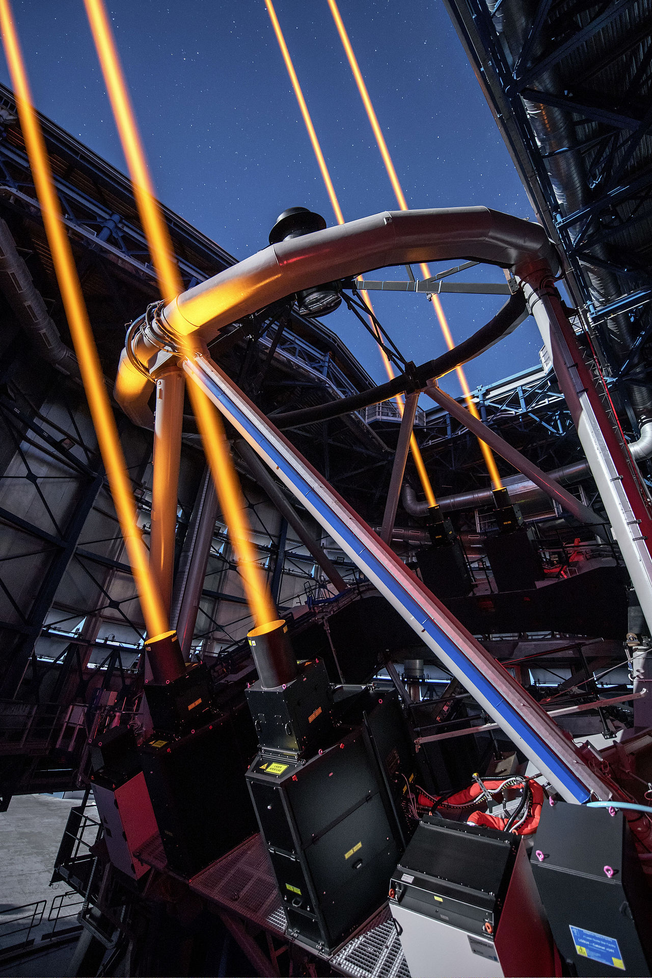
First, some pretty pictures
Lick Observatory
ESO VLT
Credit: Laurie Hatch
Credit: ESO/G. Hüdepohl

Slide 3
Movie of 3 lasers in operation on Mauna Kea, HI:
https://vimeo.com/24338510

Slide 4
Outline of lectures on laser guide stars
Why are laser guide stars needed?
Principles of laser scattering in the atmosphere
  Rayleigh scattering, resonant scattering from sodium
What is the sodium layer? How does it behave?
Physics of sodium atom excitation
Lasers used in astronomical laser guide star AO
Wavefront errors for laser guide star AO

Slide 5
Laser guide stars: Main points
Laser guide stars are needed because there aren’t enough bright natural guide stars in the sky
  Hence YOUR favorite galaxy probably won’t have a bright enough natural guide star nearby
Solution: make your own guide star using lasers
  Nothing special about coherent light - could use a flashlight hanging from a “giant high-altitude helicopter”
  Size on sky has to be ≲ diffraction limit of a WFS sub-aperture
Laser guide stars have pluses and minuses:
  Pluses: can put them anywhere, can be bright
  Minuses: NGS give better AO performance than LGS even when both are working perfectly. High-powered lasers are tricky to build and work with. Laser safety is added complication.

Slide 6
Two types of laser guide stars in use today: “Rayleigh” and “Sodium”
Sodium guide stars: excite atoms in “sodium layer” at altitude of ~ 95 km
Rayleigh guide stars: Rayleigh scattering from air molecules sends light back into telescope, h ~ 10 km
Higher altitude of sodium layer is closer to sampling the same turbulence that a star from “infinity” passes through
~ 95 km
8-12 km
Turbulence
Telescope

Slide 7
Reasons why laser guide stars can’t do as well as bright natural guide stars
1) Laser light is spread out by turbulence on the way up.
  Spot size is finite (0.5 - 2 arc sec)
  Can increase measurement error of wavefront sensor
    Harder to find centroid if spot is larger
2) For Rayleigh guide stars, some turbulence is above altitude where light is scattered back to telescope.
Hence it can’t be measured.
3) For both kinds of guide stars, light coming back to telescope is spherical wave, but light from “real” stars is plane wave
  Some turbulence around edges of the pupil isn’t sampled well

Slide 8
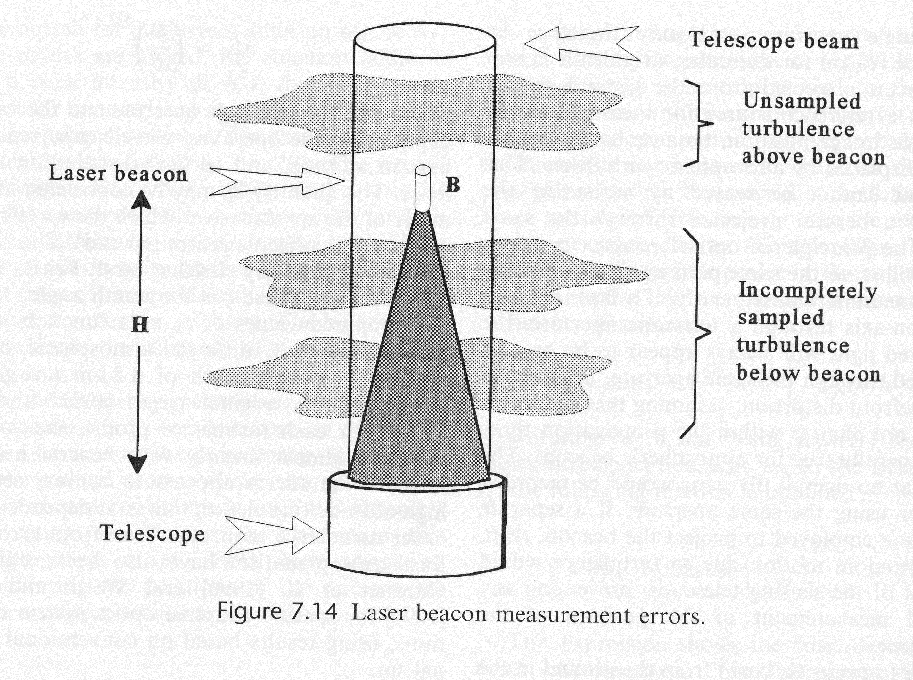
Laser beacon geometry causes measurement errors
Credit: Hardy

Slide 9
Why are laser guide stars needed?
Wavefront error due to anisoplanatism:
Example: At Keck θ₀ ~ 10 arc sec x ( λ / 0.5 micron)^{6/5}
What is σ_{ϕ}² for θ = 40 arc sec at λ = 1 micron?
What is Strehl loss due to anisoplanatism?
Answers: σ_{ϕ}² = 2.52 rad², Strehl = 0.08 x Strehl at θ = 0

Slide 10
How many bright stars are there?
There are about 6 million stars in the whole sky brighter than 13th magnitude
Area of sky = 4 π r² = 4 π (360 / 2π)²
sky contains (360 deg)² / π sq deg = 41,253 sq deg
Question: How many stars brighter than 13th mag are there per square arc sec on the sky?
Notes:
Answer: 10⁻⁵ stars per square arc sec (!!!)

Slide 11
How many bright stars are there?
There are about 6 million stars in the whole sky brighter than 13th magnitude
Area of sky = 4 π r² = 4 π (360 / 2π)²
sky contains (360 deg)² / π sq deg = 41,253 sq deg
Question: How many stars brighter than 13th mag are there per square arc sec on the sky?
Answer: 10⁻⁵ stars per square arc sec (!)
Notes:
Answer: 10⁻⁵ stars per square arc sec (!!!)

Slide 12
If we can only use guide stars closer than ~ 40 arc sec, sky coverage is low!
High-order Shack-Hartmann AO systems typically need guide stars brighter than magnitude V ~ 13.5
[V band: central wavelength ~ 0.54 μm]
Surface density of these stars on the sky is Σ ~ 10⁻⁵ / (arc sec)²
So probability P of finding bright enough guide star w/in radius of 40 arc sec of an arbitrary place in the sky is
P = Σ π (40)² = 10⁻⁵ π (40)² = 0.05
Magnitude V ~ 13.5 stars only have 5% sky coverage,
at least for Shack Hartmann sensors!

Slide 13
Solution: make your own guide star using a laser beam
Point the laser beam directly at YOUR favorite astronomical target
Use scattering of laser light by the atmosphere to create an “artificial” guide star
  Sometimes called “synthetic beacon” or “artificial beacon”
What physical mechanism causes the laser light to scatter back down into your telescope’s wavefront sensor?

Slide 14
Scattering: 2 different physical processes
Rayleigh Scattering (Rayleigh beacon)
  Elastic scattering from atoms or molecules in atmosphere. Works for broadband light, no change in frequency
Resonance Scattering (Sodium Beacon)
  Line radiation is absorbed and emitted with no change in frequency.

Slide 15
Regardless of the type of scattering...
Number of photons detected =
(number of transmitted photons
x probability that a transmitted photon is scattered
x probability that a scattered photon is collected
x probability that a collected photon is detected)
+ background photons (noise)

Slide 16
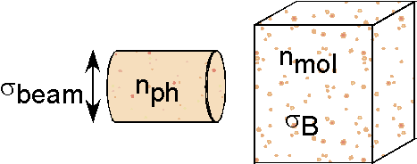
Amount of Photon Scattering
n_{ph} = # of photons
σ_{beam} = laser beam cross- section
n_{mol} = density of scatterers
σ_{B} = scattering cross-section
# molecules hit by laser beam in volume σ_{beam} Δz = n_{mol} (σ_{beam} Δz )
Percentage of beam scattered = [ n_{mol} ( σ_{beam} Δz ) ] σ_{B} /σ _{beam}
Total number of photons scattered = ( E_{L} / hν ) ( n_{mol}σ_{B} Δz )
E_{L} and ν are laser’s energy and frequency, h is Planck’s constant

Slide 17
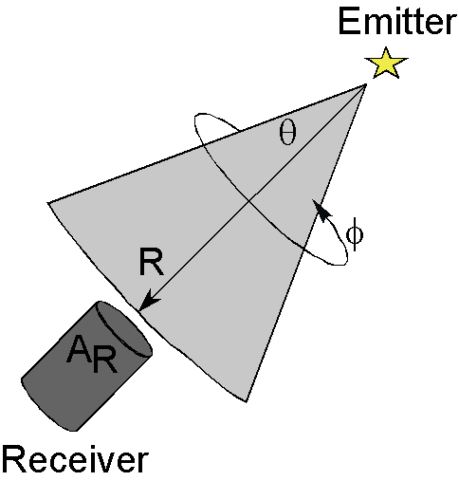
Percentage of photons collected
Assuming uniform emission over 2π steradians, scattered photons are uniformly distributed over area
Percentage of photons collected = A_{R} / ( 4 π R²) where A_{R} is receiver area

Slide 18
LIDAR Equation
(LIght Detection And Ranging)
Transmission thru optics and atmosphere, detector efficiency
Number of photons
detected in range interval Δz
Percentage
of beam
scattered
Initial
number of
photons
Percentage
of scattered photons
that are collected
Background
photons

Slide 19
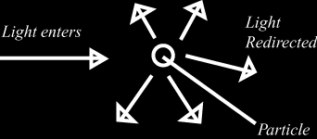
Rayleigh Scattering
Due to interactions of the electromagnetic wave from the laser beam with molecules in the atmosphere.
The light’s electromagnetic fields induce dipole moments in the molecules, which then emit radiation at same frequency as the exciting radiation (elastic scattering).

Slide 20
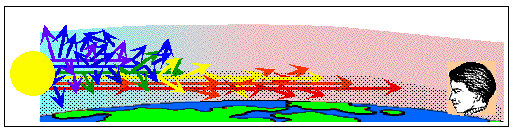
Rayleigh Scattering cross section
Rayleigh backscattering cross section is
  where λ is laser wavelength
Scattering ∝ λ⁻ ⁴ ⇒ use shorter wavelength lasers for better scattering efficiency
Why sunsets look red:

Slide 21
Dependence of Rayleigh scattering on altitude where the scattering occurs
Product of Rayleigh scattering cross section with density of molecules is
  where P(z) is the pressure in millibars at altitude z, and T(z) is temperature in degrees K at altitude z
Because pressure P(z) falls off exponentially with altitude, Rayleigh beacons are generally limited to altitudes below 8 - 12 km

Slide 22
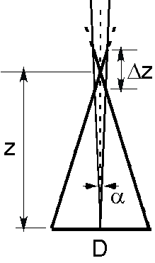
Rayleigh laser guide stars use timing of laser pulses to detect light from Δz
Use a pulsed laser, preferably at a short wavelength (UV or blue or green) to take advantage of λ⁻⁴
Cut out scattering from altitudes lower than z by taking advantage of light travel time z/c
Only open shutter of your wavefront sensor when you know that a laser pulse has come from the desired scattering volume Δz at altitude z

Slide 23
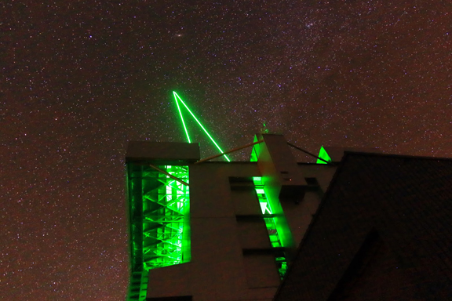
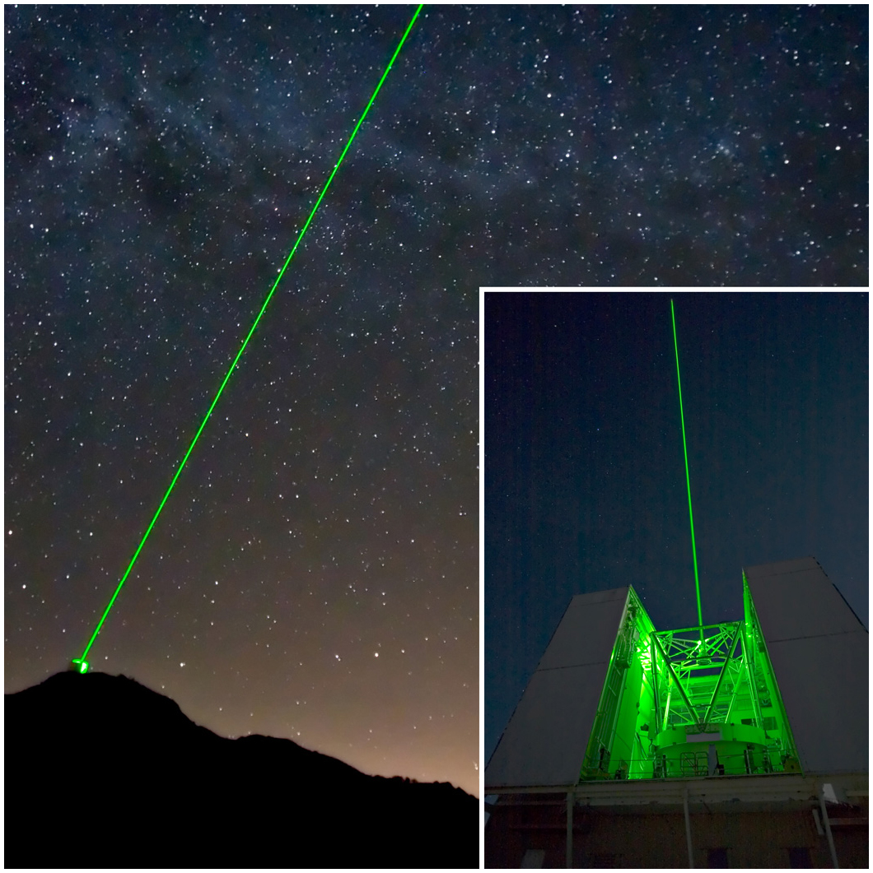
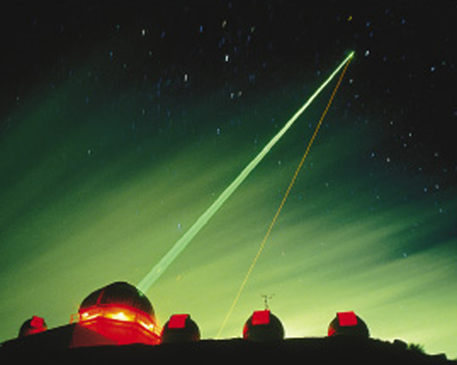
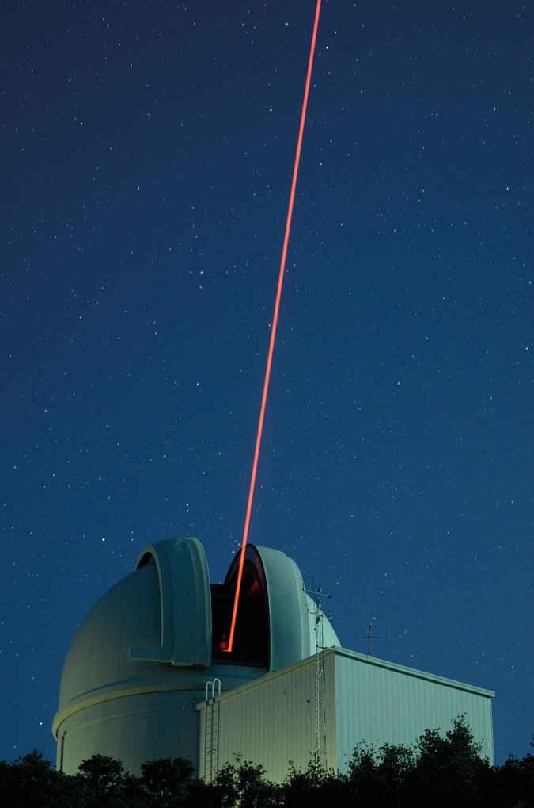
Rayleigh laser guide stars
MMT laser guide star, Arizona
LBT ARGOS
laser guide star
Starfire Optical Range, NM. Quite a few years ago.
Robo-AO
UV laser

Slide 24
Outline of laser guide star topics
Why are laser guide stars needed?
Principles of laser scattering in the atmosphere
What is the sodium layer? How does it behave?
Physics of sodium atom excitation
Lasers used in astronomical laser guide star AO
Wavefront errors for laser guide star AO

Slide 25
Sodium Resonance Fluorescence
Resonance scattering occurs when incident laser is tuned to a specific atomic transition.
Absorbed photon raises atom to excited state. Atom emits photon of same wavelength via spontaneous or stimulated emission, returning to original lower state.
Large absorption and scattering cross-sections.
Layer in mesosphere ( h ~ 95 km, Δh ~ 10 km) containing alkali metals, sodium (10³ - 10⁴ atoms/cm³), potassium, calcium
Strongest laser return is from D₂ line of Na at 589 nm.

Slide 26
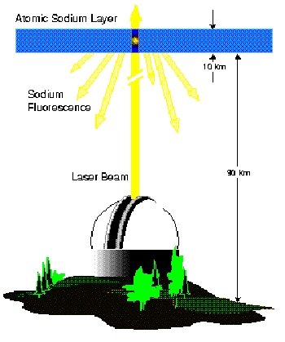
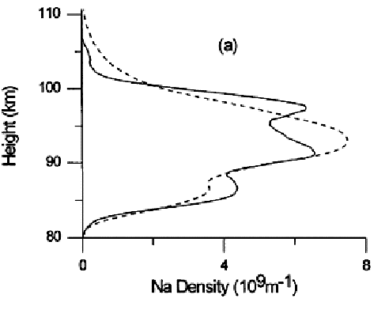
The atmospheric sodium layer: altitude ~ 95 km , thickness ~ 10 km
Credit: Clemesha, 1997
Credit: Milonni, LANL
Layer of neutral sodium atoms in mesosphere (height ~ 95 km)
Thought to be deposited as smallest meteorites burn up

Slide 27
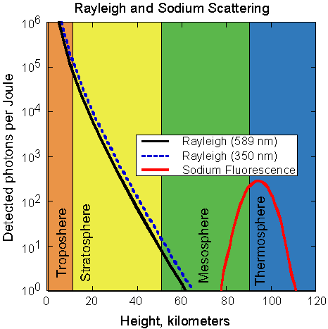
Rayleigh scattering vs. sodium resonance fluorescence
Atmosphere has ~ exponential density profile:
Cartoon
M = molecular mass, n = no. density, T = temperature, k = Planck’s constant, g = gravitational acceleration
Rayleigh scattering dominates over sodium fluorescence scattering below h = 75 km.

Slide 28

Image of sodium light taken from telescope very close to main telescope
View is highly fore-shortened
Light from Na layer at ~ 100 km
Max. altitude of Rayleigh ~ 35 km
Rayleigh scattered light
from low altitudes

Slide 29
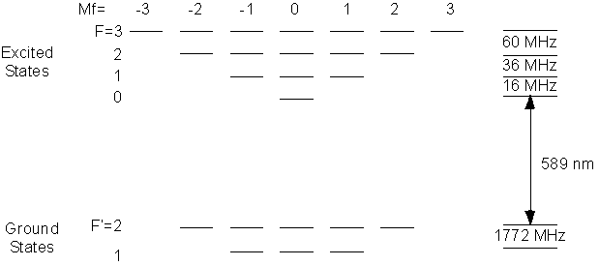
Can model Na D₂ transition as a two-level atom (one valence electron)
Hyperfine splitting
Hyperfine splitting (not to scale)
Hyperfine splitting: spins of valence electron and nucleus are (or are not) aligned
Separation between upper three hyperfine states is small
Separation bet. two ground states is large: 1.8 GHz

Slide 30
Overview of sodium physics
Column density of sodium atoms is relatively low
  Less than 600 kg in whole Earth’s sodium layer!
When you shine a laser on the sodium layer, the optical depth is only a few percent. Most of light just keeps on going upwards.
Natural lifetime of D₂ transition is short: 16 nsec
Can’t just pour on more laser power, because sodium D₂ transition saturates:
  Once all the atoms that CAN be in the excited state ARE in the excited state, return signal stops increasing even with more laser power

Slide 31
Origin of sodium layer
Layer 10 km thick, at an altitude of 90 km - 105 km in the Earth’s “mesosphere”
Thought to be due to meteorites: at this altitude, small meteorites aimed toward the Earth first get hot enough to evaporate
  Deposit their elements in atmosphere in atomic state: iron, potassium, sodium, lithium, …..
  Atomic layer is “eaten away” at its bottom by chemical reactions (e.g. oxidation reactions)

Slide 32
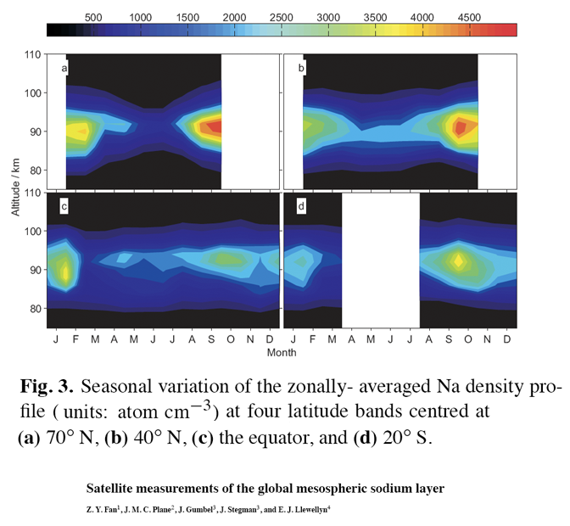
Sodium abundance varies with season
Equatorial regions: density is more constant over the year, but peak is lower
Temperate regions: lowest density in summer
  Chemical reactions at bottom of layer
70°N
40°N
Equator
20°S

Slide 33
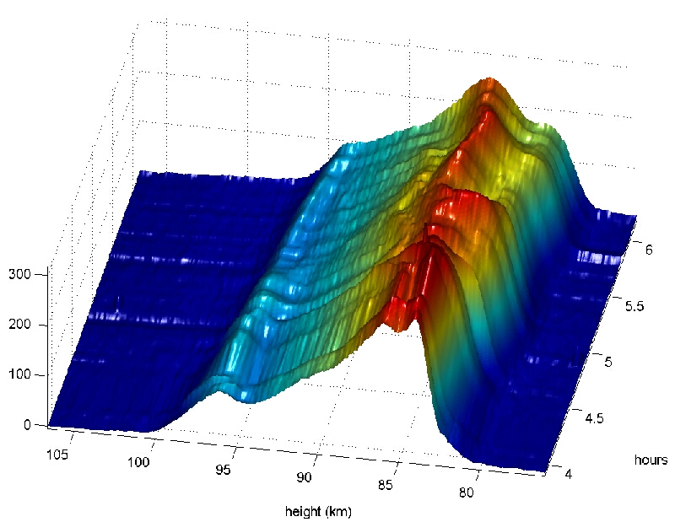
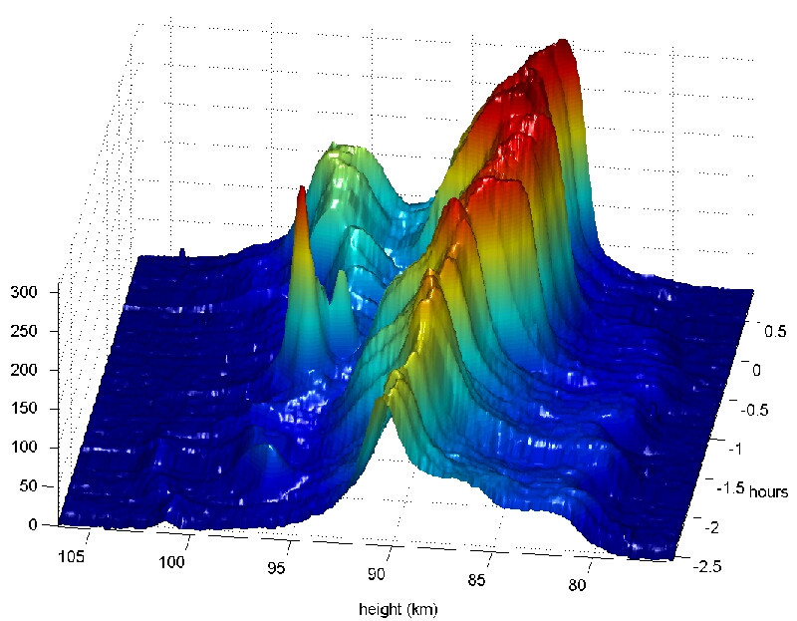
Time variation of Na density profiles over periods of 4 - 5 hours
Night 1: single peaked
Night 2: double peaked
At La Palma, Canary Islands

Slide 34
Outline of laser guide star topics
Why are laser guide stars needed?
Principles of laser scattering in the atmosphere
What is the sodium layer? How does it behave?
Physics of sodium atom excitation
Lasers used in astronomical laser guide star AO
Wavefront errors for laser guide star AO

Slide 35
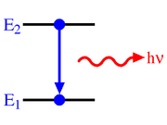
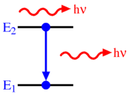
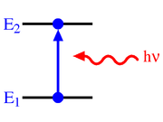
Atomic processes for two-level atom
Einstein, 1916: atom interacts with light in 3 ways
  Spontaneous emission
  Stimulated emission
  Absorption
Graphics credit: Wikipedia

Slide 36
Saturation effects in the Na layer, from Ed Kibblewhite
Consider a two level atom which initially has a ground state n containing N_{n} atoms and an empty upper state m. The atom is excited by a radiation field tuned to the transition
ν = E_{m}- E_{n}/h, hν >> kT
In equilibrium B_{nm} U(ν) N_{n} = A_{mn}N_{m} +B_{mn} U(ν) N_{m}
A_{mn} is Einstein's A coefficient (= 1/lifetime in upper state). B_{nm} = B_{mn} = Einstein’s B coefficient. U(ν) is the radiation density in units of Joules/cm³ Hz

Slide 37
Check units:
(cm³ Hz / erg) sec⁻¹
# atoms
B_{nm} U(ν) N_{n} = A_{mn} N_{m} + B_{mn} U(ν) N_{m}
ergs / cm³ Hz
sec⁻¹ per atom

Slide 38
Saturation, continued
Solve for N_{m} = N_{n} B_{nm} U(ν) / [ B_{nm} U(ν) + A_{mn}]
If we define the fraction of atoms in level m as f and the fraction in level n as ( 1 - f ) we can rewrite this equation as
f = B_{mn} U(ν) (1 - f ) / (B_{mn} U(ν) + A_{mn})
f = 1/[2 + A_{mn}/ B_{mn}U(ν)]
This equation shows that at low levels of radiation U(ν) the fraction of atoms in the upper level is B_{mn} U(ν) / A_{mn}
As the radiation density increases, fraction of atoms in upper level saturates to a maximum level of 1/2 for an infinite value of U (ν).
Define a saturation level as radiation field generating 1/2 this max:
U_{sat}(ν) = A_{mn}/2B_{mn}

Slide 39
U_{sat} is not a cliff: fraction in upper state keeps increasing for U >> U_{sat}
linear response to increased laser power

Slide 40
Saturation, continued
The ratio A_{mn}/B_{mn} is known from Planck's black body formula and is equal to 8πhν³/c³ joules cm⁻³ Hz
The intensity of the radiation field I ( ν) is related to U ( ν) by
I (ν) = U ( ν) c watts/cm² Hz
I_{sat} ≈ 9.48 mW/cm² for linearly polarized light
In terms of photons N_{sat} = a few x 10¹⁶ photons/sec.
CW (continuous wave) lasers produce more return/watt than pulsed lasers because of lower peak power

Slide 41
Laser guide stars: Main points so far
Laser guide stars are needed because there aren’t enough bright natural guide stars in the sky
Solution: make your own guide star
  Using lasers
  Nothing special about coherent light
  Size on sky has to be ≲ diffraction limit of a WFS sub-aperture
Rayleigh scattering: from ~10-15 km:
  Doesn’t sample turbulence as well as resonant scattering from Na layer at ~100 km. Lasers are cheaper, and easier to build.
Sodium laser guide stars:
  Sodium column density varies with season, and within a night
  Need to sense variation and follow it

Slide 42
Outline of laser guide star topics
Why are laser guide stars needed?
Principles of laser scattering in the atmosphere
What is the sodium layer? How does it behave?
Physics of sodium atom excitation
Lasers used in astronomical laser guide star AO
Wavefront errors for laser guide star AO

Slide 43
Types of lasers: Outline
Principle of laser action
Lasers used for Rayleigh guide stars
Lasers used for sodium guide stars

Slide 44
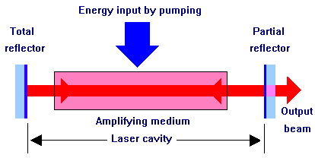
Overall layout (any kind of laser)

Slide 45
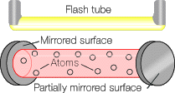
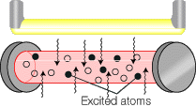
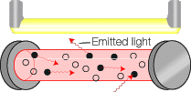


Principles of laser action
Stimulated emission
Mirror

Slide 46
General comments on guide star lasers
Typical average powers of a few watts to 20 watts
  Much more powerful than typical laboratory lasers
Na guide stars - Class IV lasers (a laser safety category)
  “Significant eye hazards, with potentially devastating and permanent eye damage as a result of direct beam viewing”
  “Able to cut or burn skin”
  “May ignite combustible materials”
As a result, need to avoid airplanes and satellites

Slide 47
Lasers used for Rayleigh guide stars
Rayleigh x-section ~ λ⁻⁴ ⇒ short wavelengths better
Commercial lasers are available
  Reliable, relatively inexpensive
  Green laser (532nm) – e.g. MMT
  RoboAO uses 10W ultraviolet (λ = 355nm) laser pulsed at 10 kHz
    Invisible to human eye. Unable to flash-blind pilots; considered a Class 1 laser (incapable of producing damaging radiation levels during operation and exempt from any control measures). So no need for "laser spotters" as needed with Na lasers.

Slide 48
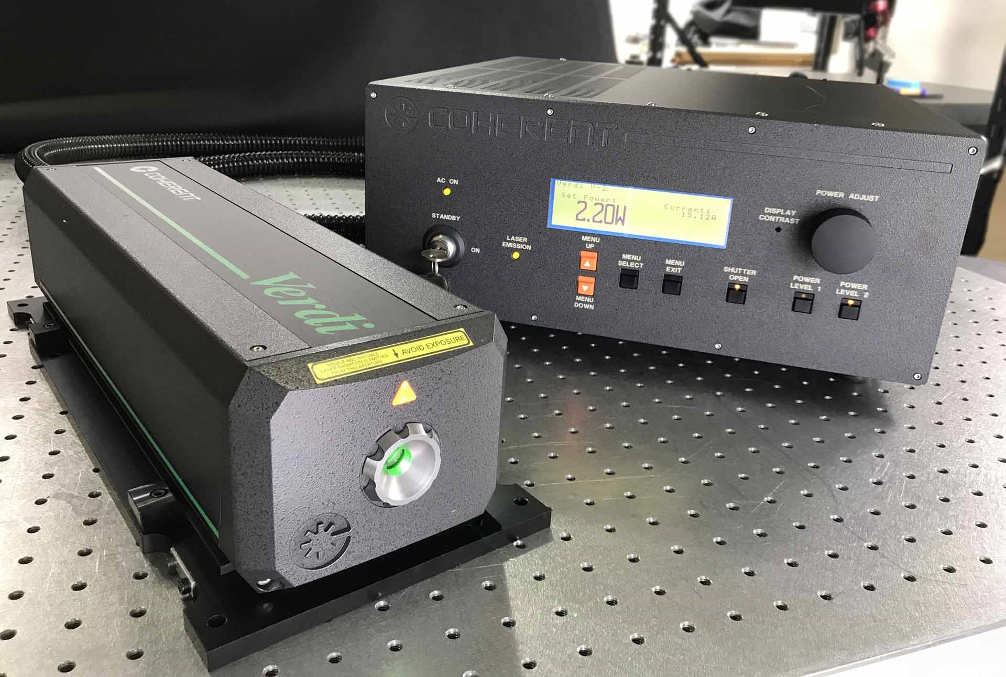
Example of laser for Rayleigh guide star: Frequency doubled Nd:YAG lasers
Nd:YAG means “neodimium-doped yttrium aluminum garnet”
Nd:YAG emits at 1.06 micron
Use nonlinear crystal to convert two 1.06 micron photons to one 0.53 micron photon (2 X frequency)
Example: Coherent’s Verdi laser
  Pump light: from laser diodes
  Very efficient
  Available up to 18 Watts
  Pretty expensive
    It’s always worrisome when price isn’t listed on the web!

Slide 49
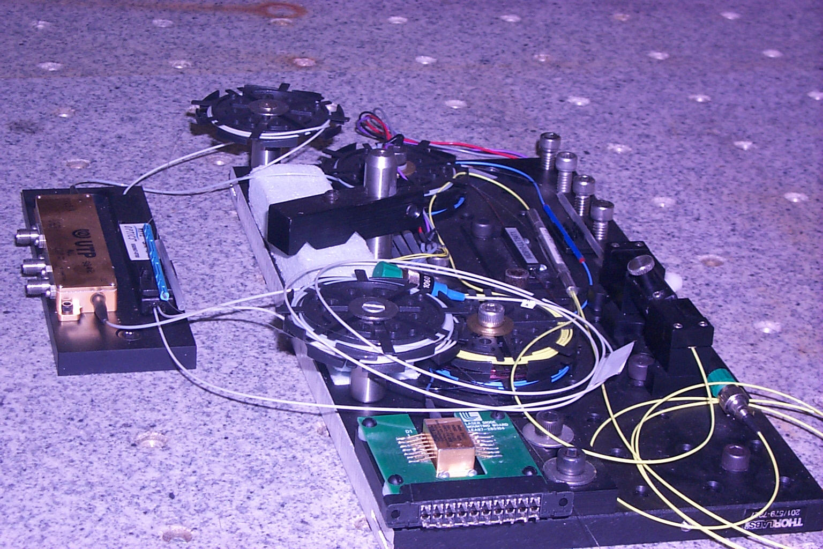
Current generation of Na lasers: all-fiber laser (Toptica, LLNL and UCSC)
Example of a fiber laser

Slide 50
Advantages of fiber lasers
Very compact
Commercial parts from telecommunications industry
Efficient:
  Pump with laser diodes - high efficiency
  Pump fiber cladding all along its length - excellent surface to volume ratio
Two types of fiber lasers have been demonstrated at the required power levels at 589 nm (Toptica in Europe, Daren Dillon at UCSC plus Jay Dawson at LLNL)

Slide 51
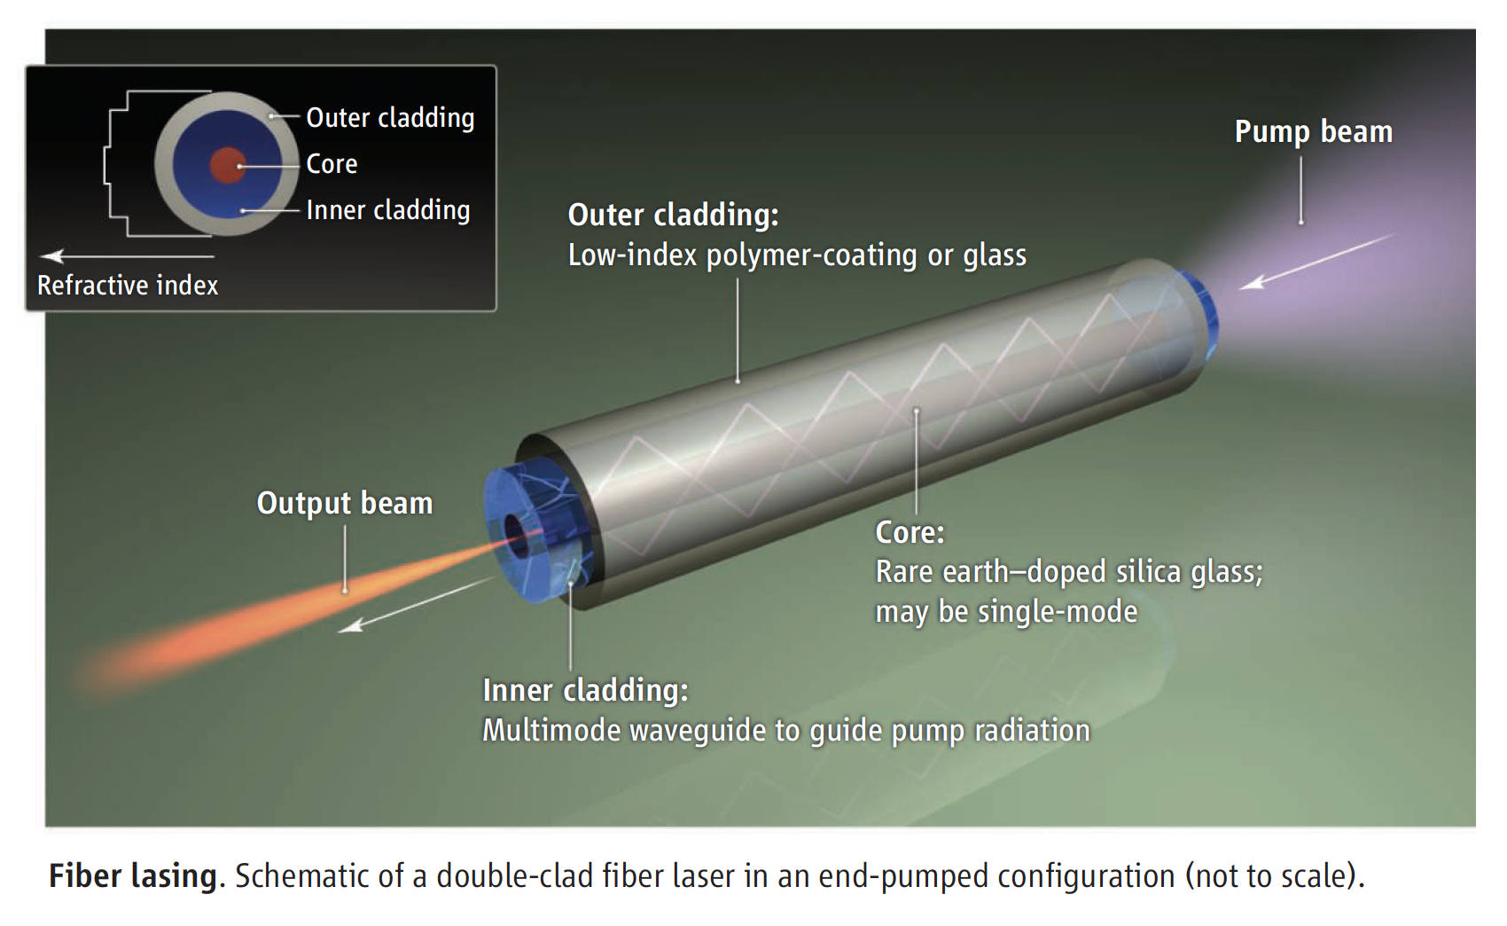
Pump light propagates through cladding, pumps doped fiber all along its length
Credit: Nilsson and Payne, Science Magazine, 2011

Slide 52
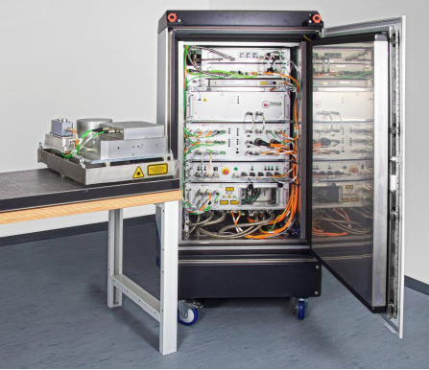
Toptica fiber laser (ESO, Keck 2, Gemini)
Fiber laser
Electronics and cooling

Slide 53
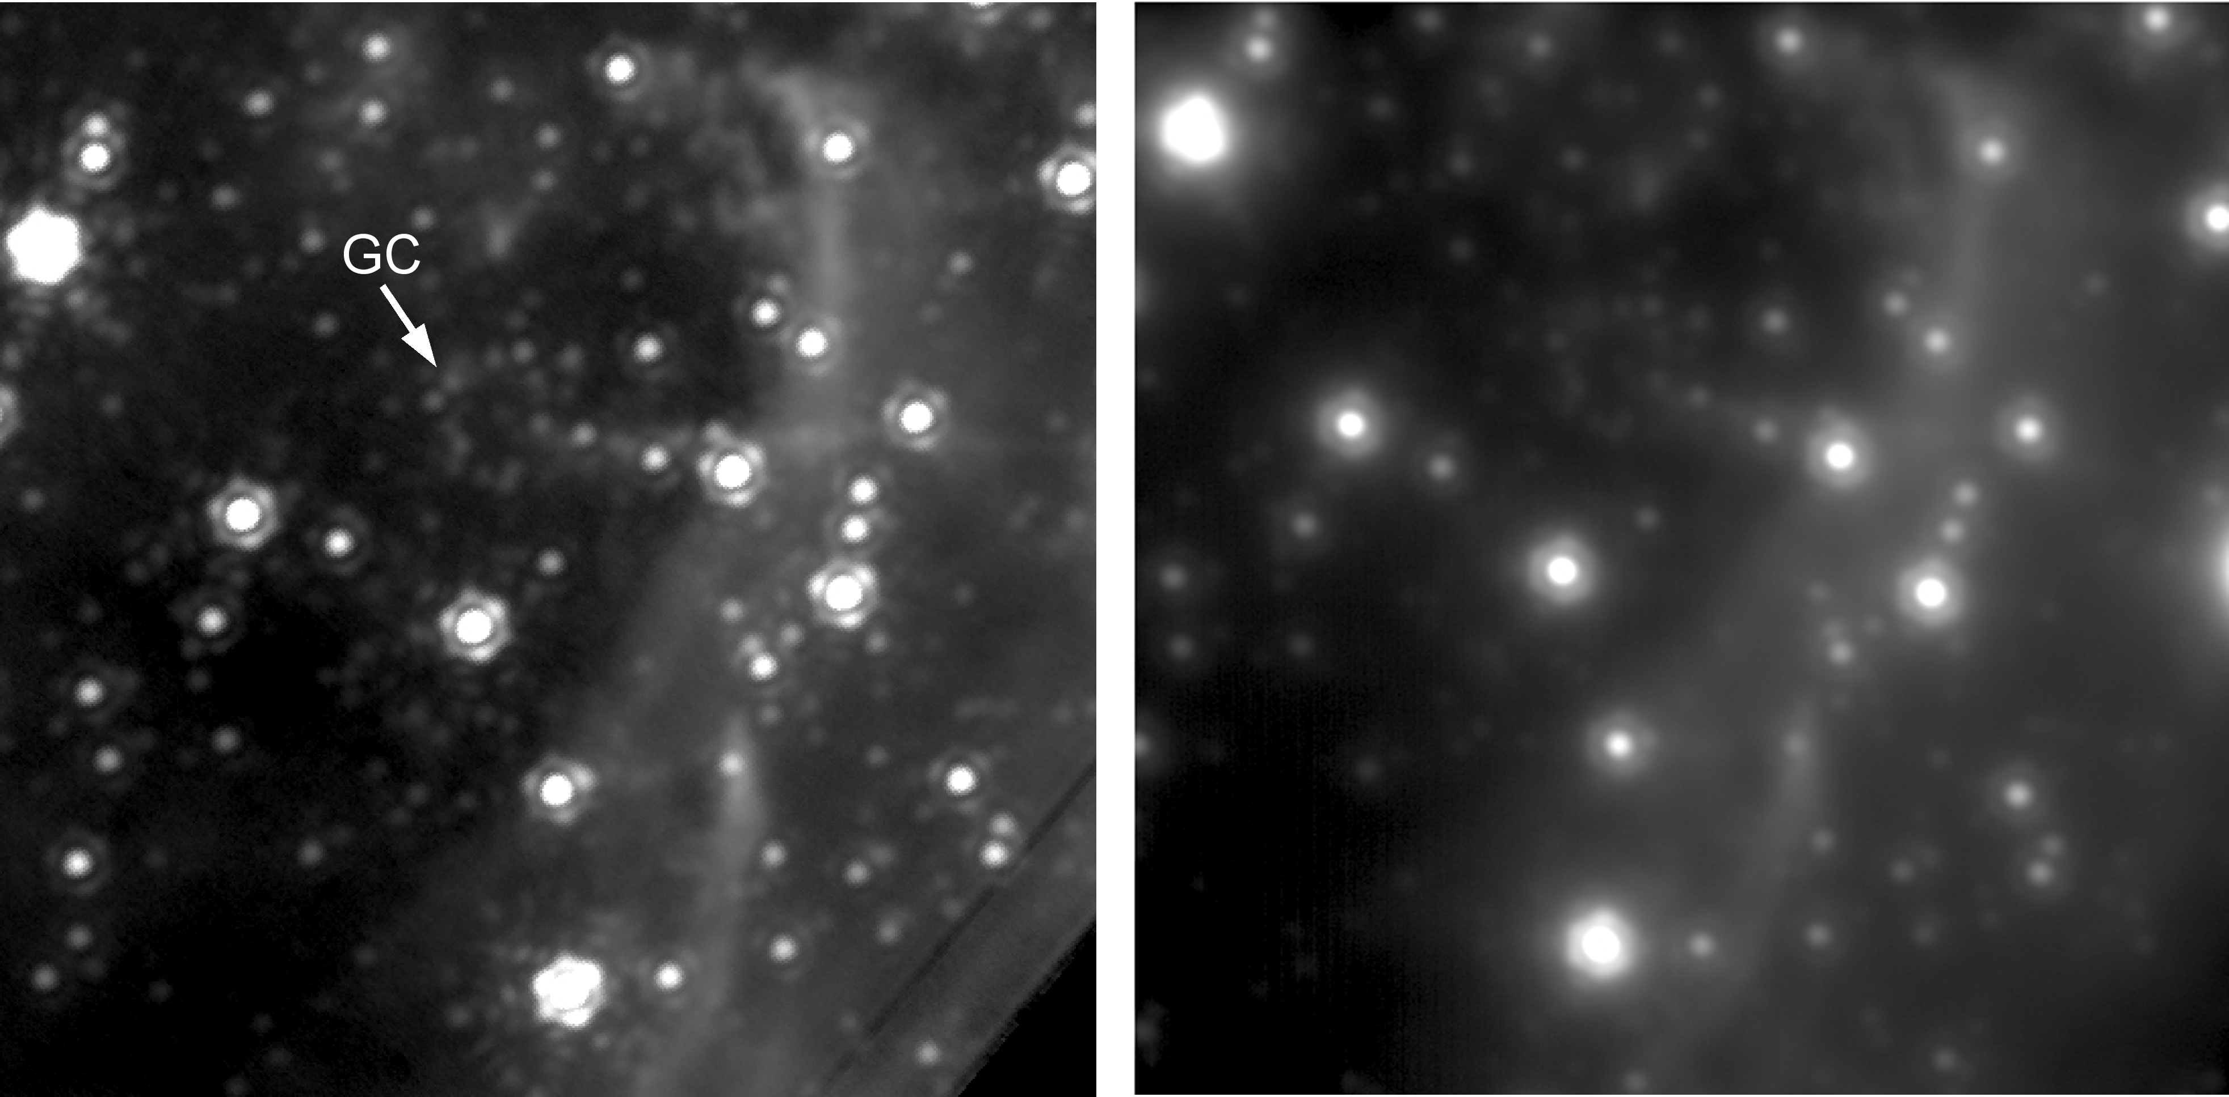
Galactic Center with Keck laser guide star AO
Keck laser guide star AO
Best natural guide star AO
Andrea Ghez, UCLA group

Slide 54
Outline of laser guide star topics
Why are laser guide stars needed?
Principles of laser scattering in the atmosphere
What is the sodium layer? How does it behave?
Physics of sodium atom excitation
Lasers used in astronomical laser guide star AO
Wavefront errors for laser guide star AO

Slide 55
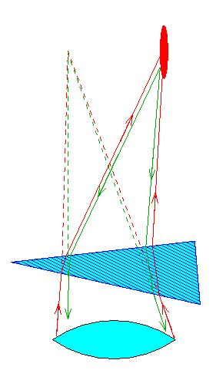
Laser guide star AO needs to use a faint tip-tilt star to stabilize laser spot on sky
from A. Tokovinin

Slide 56
Effective isoplanatic angle for image motion: “isokinetic angle”
Image motion is due to low order modes of turbulence
  Measurement is integrated over whole telescope aperture, so only modes with the largest wavelengths contribute (others are averaged out)
Low order modes change more slowly in both time and in angle on the sky
“Isokinetic angle”
  Analogue of isoplanatic angle, but for tip-tilt only
  Typical values in infrared: of order 1 arc min

Slide 57
Tip-tilt mirror and sensor configuration
Telescope
Deformable mirror
Tip-tilt mirror
Beam splitter
Wavefront sensor
Tip-tilt sensor
Beam splitter
Imaging camera

Slide 58
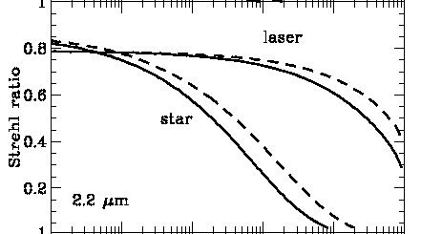

Sky coverage is determined by distribution of (faint) tip-tilt stars
Keck: >18th magnitude
1
Galactic latitude = 90°
Galactic latitude = 30°
271 degrees of freedom
5 W cw laser
0
From Keck AO book

Slide 59
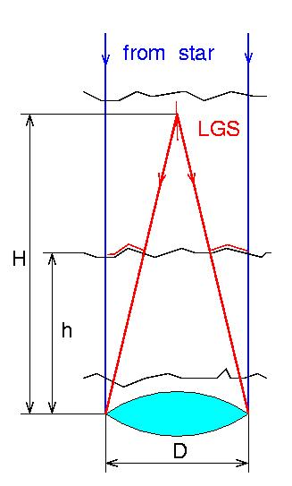
“Cone effect” or “focal anisoplanatism” for laser guide stars
Two contributions:
  Unsensed turbulence above height of guide star
  Geometrical effect of unsampled turbulence at edge of pupil
from A. Tokovinin

Slide 60
Cone effect, continued
Characterized by parameter d₀
Hardy Sect. 7.3.3 (cone effect = focal anisoplanatism)
σ_{FA}² = ( D / d₀)^{5/3}
Typical sizes of d₀ ~ a few meters to 20 meters

Slide 61
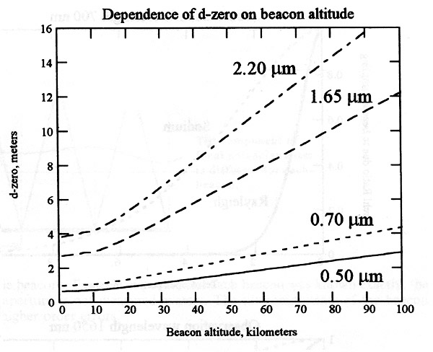
Dependence of d₀ on beacon altitude
from Hardy
One Rayleigh beacon OK for D < 4 m at λ = 1.65 micron
One Na beacon OK for D < 10 m at λ = 1.65 micron

Slide 62
Effects of laser guide star on overall AO error budget
The good news:
  Laser is brighter than your average natural guide star
    Reduces measurement error
  Can point it right at your target
    Reduces anisoplanatism
The bad news:
  Still have tilt anisoplanatism σ_{tilt}² = ( θ / θ_{tilt} )^{5/3}
  New: focus anisoplanatism σ_{FA}² = ( D / d₀ )^{5/3}
  Laser spot larger than NGS σ_{meas}² ~ ( 6.3 / SNR )²

Slide 63
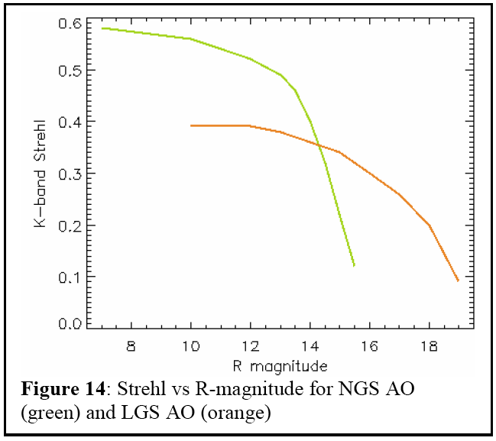
Compare NGS and LGS performance
Schematic, for visible tip-tilt star

Slide 64
Main Points
Rayleigh beacon lasers are straightforward to purchase, but single beacons are limited to medium sized telescopes due to focal anisoplanatism
Sodium layer saturates at high peak laser powers
Fiber lasers are the way to go (long pulses, low peak power)
Added contributions to error budget from LGS’s
  Tilt anisoplanatism, cone effect, larger spot

